Slide 1

iPad Restaurant Ordering Application
By: Owen Stoll, Kaushik Ramani , Nikola Soldatovic

Slide 2
Introduction
iPadTM Restaurant ApplicationTM
Managing this project presents many unique challenges
Contains both both software and hardware components
Configuring the hardware components is just as crucial as developing functional software.
An benefit of developing iPad ordering application is that there are existing examples of similar systems.

Slide 3

Objectives
Reduce time delay of the ordering process.
Provide as much information as traditional menu
Reduce costs by decreasing the number serving staff required
Customers should have the ability to remotely reserve tables.
Allow customers to give quick feedback so further improvements can be made to the cuisine , and service.
Cost of installing the system does not exceed the investors' settlement.
Restaurant/hotel managers can easily decide to revert to the traditional ordering system, or offer a blended ordering system.

Slide 4
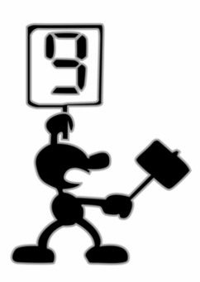
Measures of Success
System is effective in removing the middleman of the ordering process by sending orders directly to the kitchen staff.
Include all information a traditional paper menu holds by including descriptions/images/reviews/cost for each product provided by the restaurant.
System is effective in reducing the number of serving staff required.
Allow users to reserve tables at their restaurant of choice by using iPads/tablets loaned to them by room service.
After customers finish their meal, they should be able to use the iPads/tablets to rate the dishes they just ate.
Cost of installing the system was within the investors’ budget.

Slide 5
Associated Risks
Development
Risk having the ordering system user interface being too complex for users to understand and navigate.
Risk relying on a specific version / operating system to enable product functionality.
Risk not meeting all customer requirements due to miscommunication of requirements to development.
Deployment
Risk customers having difficulty understanding how to use the tablet ordering system.
Risk of security breaches through the tablet operating system by leaving the ordering app and entering the tablet operating system.
Risk of system not integrating and performing as required when deployed.

Slide 6
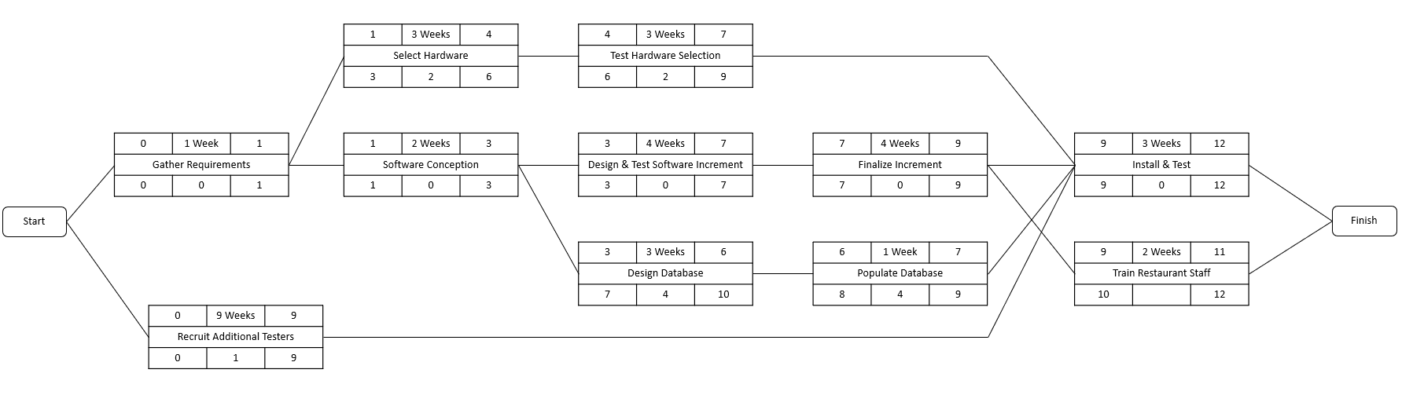
Activity Diagram

Slide 7
Infrastructure
Several iPads or other tablet devices
Stable & Secure Wifi network to connect tablets to the network
Database to store information about the menu items
Each iPad / Tablet should have a tracking feature
Order Processing System to process the customers requests

Slide 8
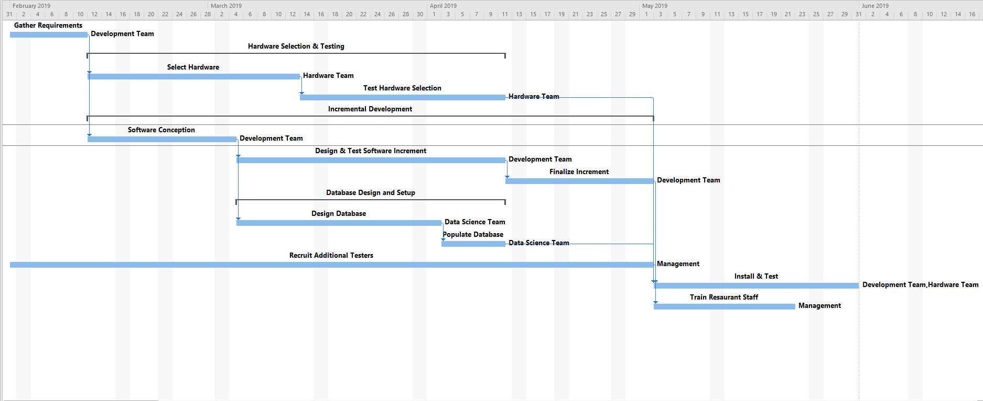
Gantt Chart

Slide 9
Thank you for your time!
Follow us on GithubTM @kaurama99 @nikolasold @owenstoll99

